Slide 1
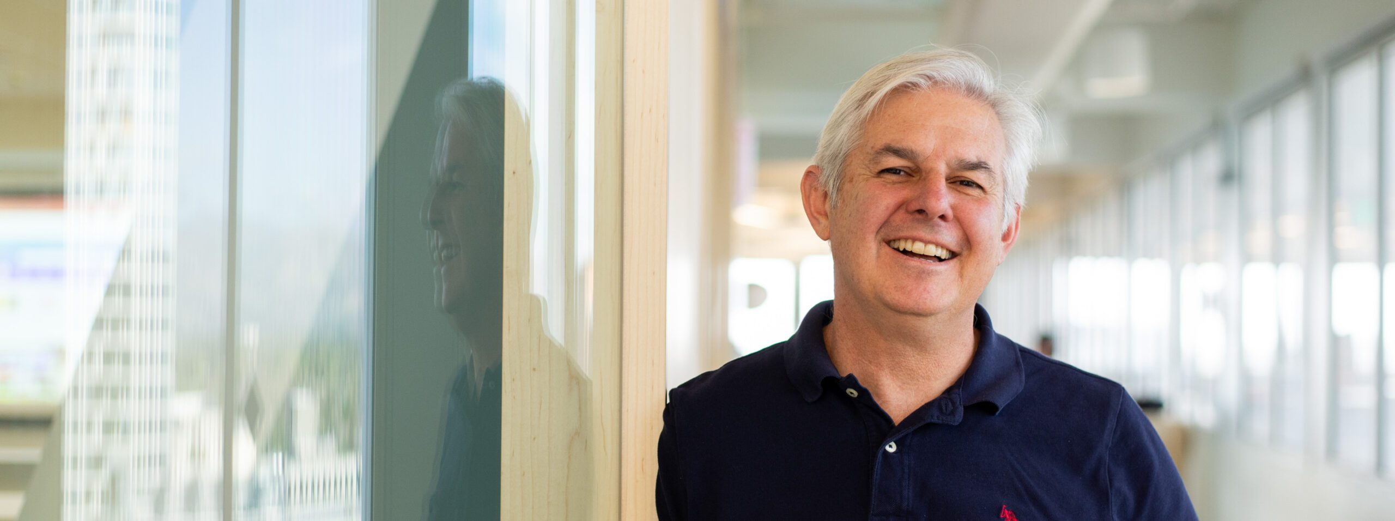
CIKM-2023 Tutorial: Some Useful Things to Know When Combining IR and NLP: the Easy, the Hard and the Ugly
Omar
Ken
Omar Alonso, Amazon, Santa Clara, CA, USA
Kenneth Church, Northeastern University, San Jose, CA, USA

Slide 2
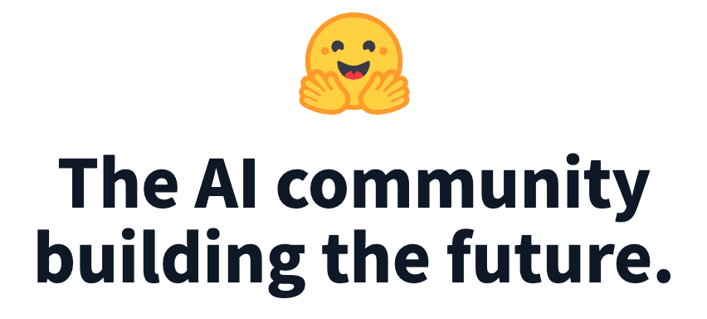
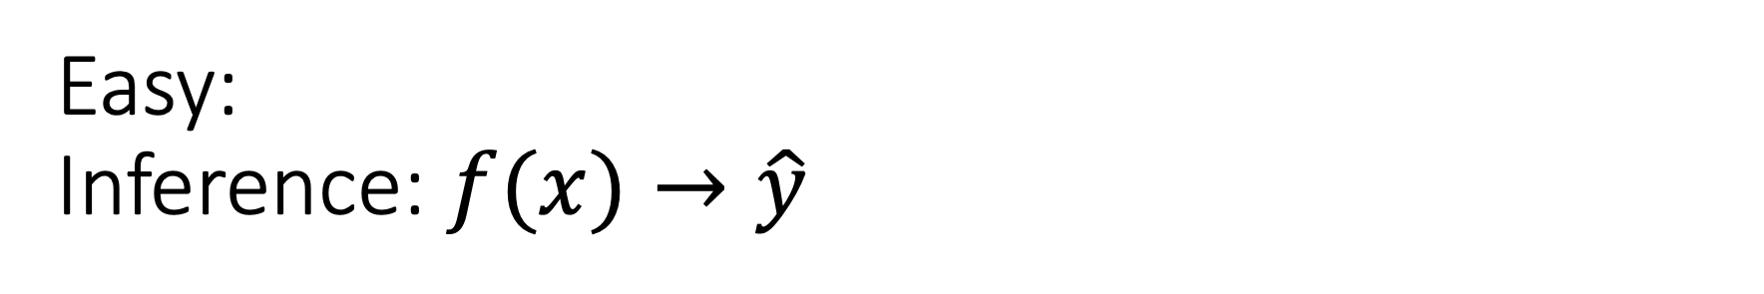
Easy: Inference: $f(x)→\hat{y}$
Classification
Sentiment
Emotion
Hate Speech
Guess Missing Word
Part of Speech Tagging
Question Answering (SQuAD)
Entailment (GLUE)
Machine Translation
Speech
Speech-to-Text
Text-to-Speech
Vision
Classify Objects
Add Captions
HuggingFace

Slide 3
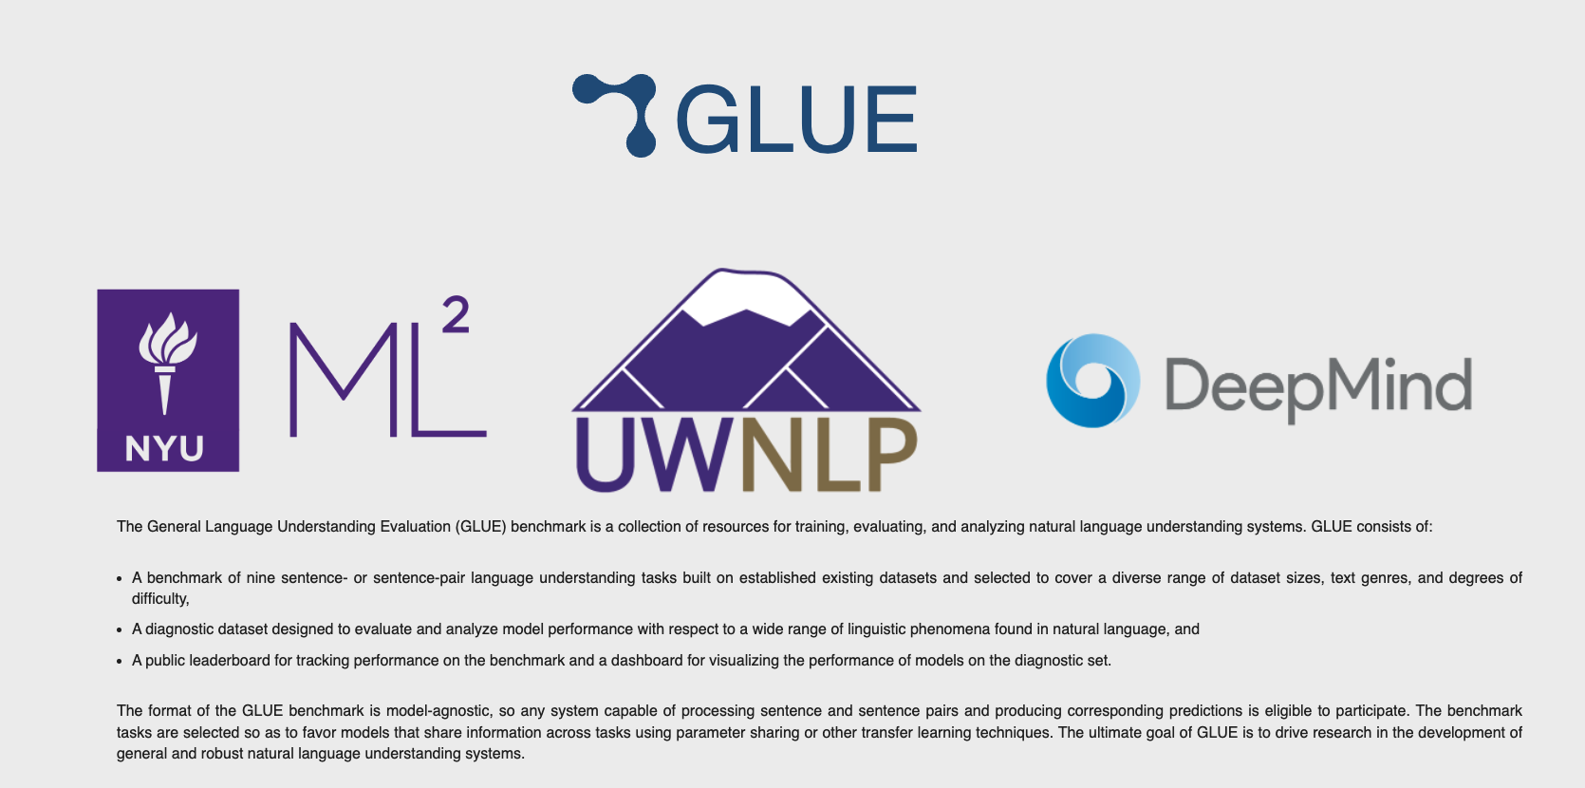
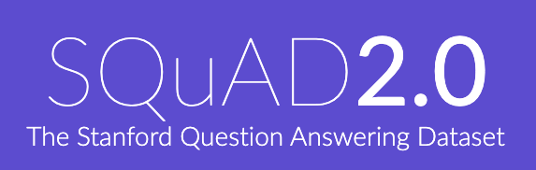
Two Popular Datasets
https://gluebenchmark.com/
https://rajpurkar.github.io/SQuAD-explorer/

Slide 4
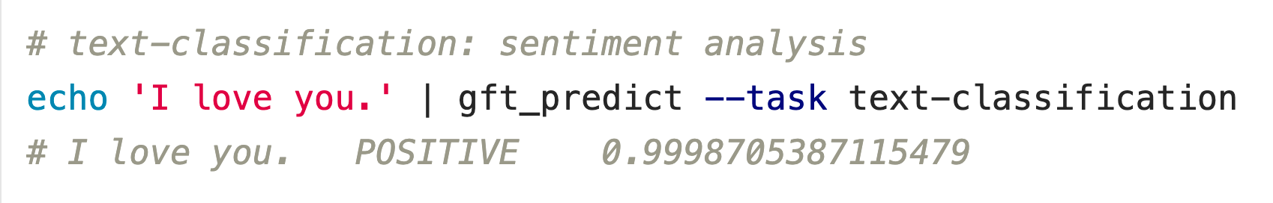



Classification
$$f\left(x\right)→\hat{y}$$
No model specified
$$x$$
$$\hat{y}$$
Score

Slide 5
Input: I love you Output: Depends on Model (among other things)
Task: classify
Models:
Sentiment
Expected output label: positive
Fake News:
Expected output label: not fake (real)
Spam/Ham:
Expected output label: not spam (ham)
for model in …
do
echo I love you |
gft_predict \
--task classify \
--model $model
done

Slide 6
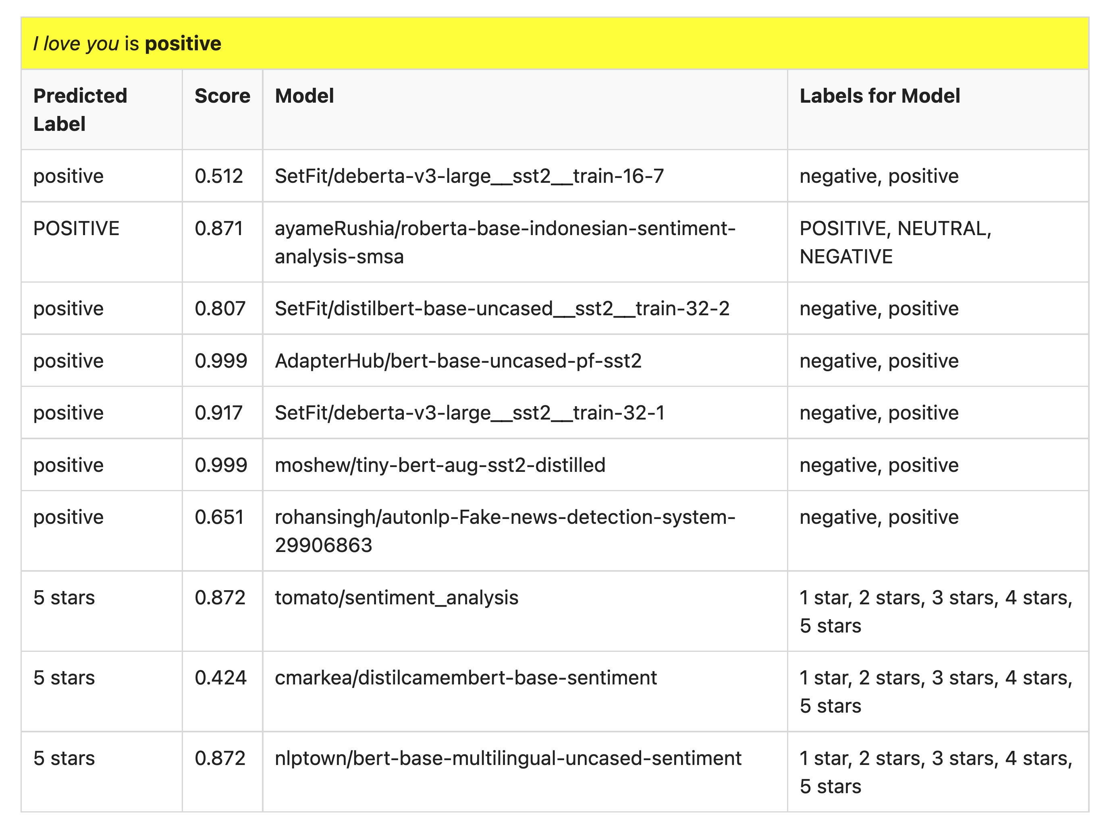
Many of these models produce reasonable results
Scores could be more confident

Slide 7
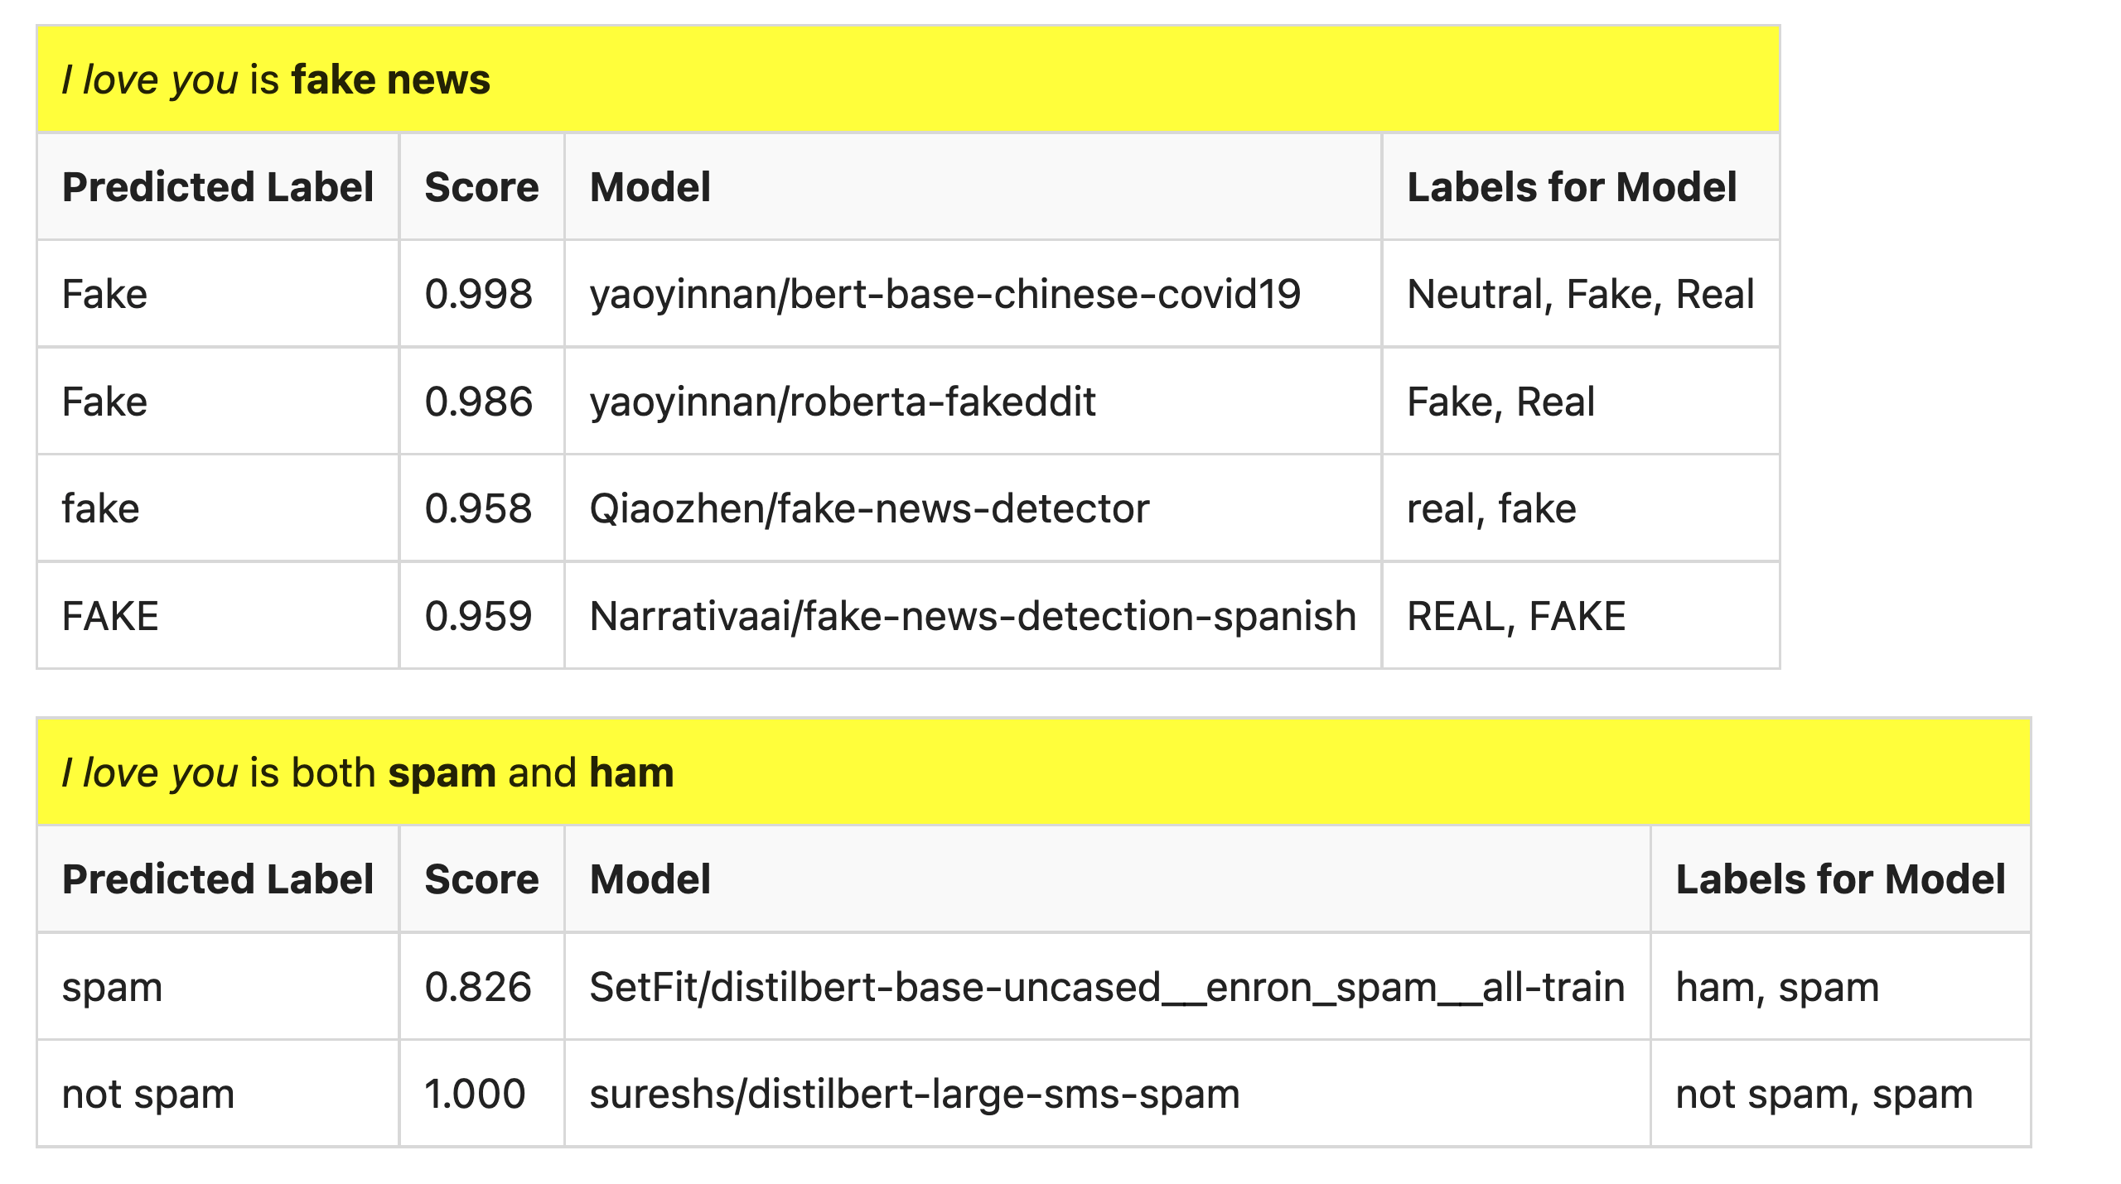
But…

Slide 8
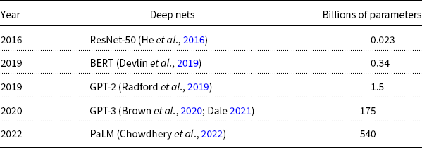
Hard: Pre-Training Large Language Models (LLMs)
GPT-3
PaLM
GPT-2
BERT
ResNet
Most users should not invest in pretraining
because growth (& costs) are out of control

Slide 9
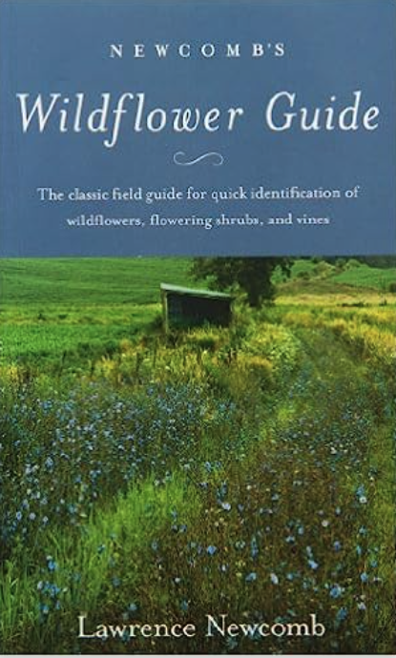
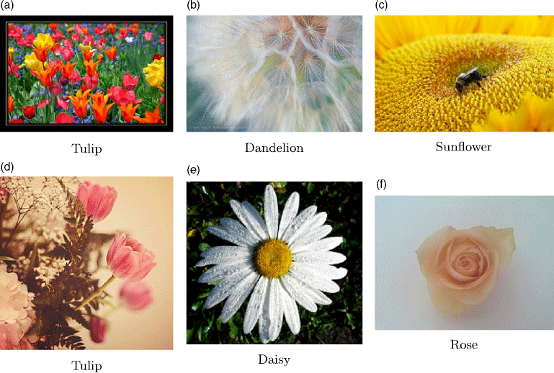
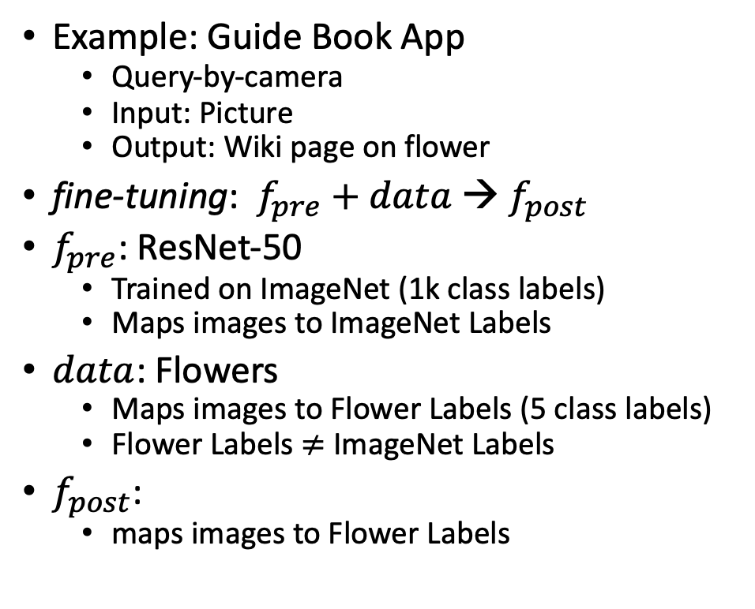

Not So Hard: Fine-Tuning
$$data$$
Flowers
Example: Guide Book App
Query-by-camera
Input: Picture
Output: Wiki page on flower
fine-tuning: $f_{pre}$ $+ data$→ $f_{post}$
$f_{pre}$: ResNet-50
Trained on ImageNet (1k class labels)
Maps images to ImageNet Labels
$data$: Flowers
Maps images to Flower Labels (5 class labels)
Flower Labels $≠$ ImageNet Labels
$f_{post}$:
maps images to Flower Labels

Slide 10
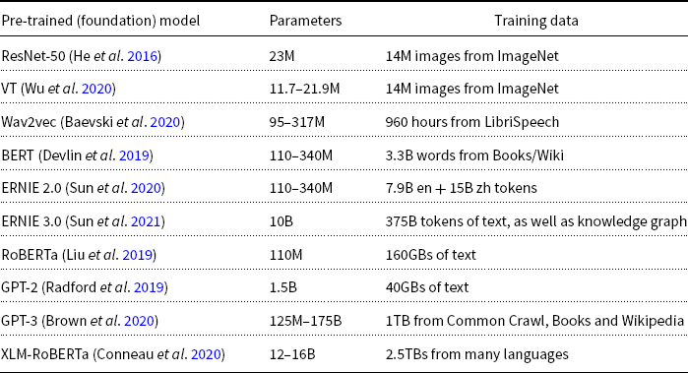
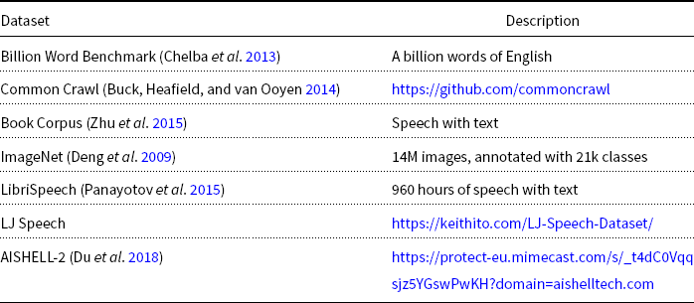
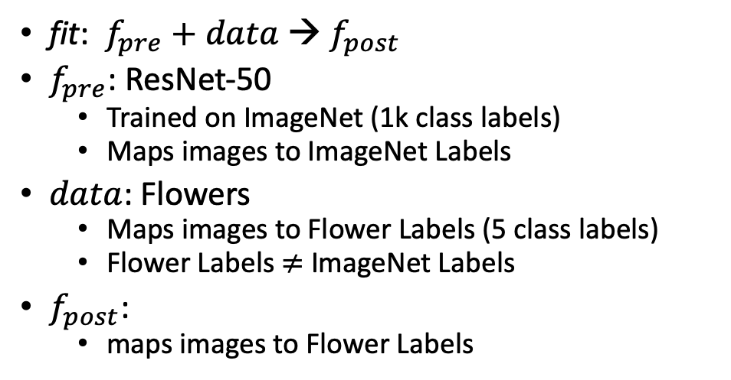

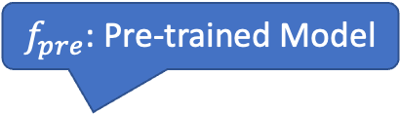
What is fine-tuning fit?
Flowers
$$data$$
fit: $f_{pre}$ $+ data$→ $f_{post}$
$f_{pre}$: ResNet-50
Trained on ImageNet (1k class labels)
Maps images to ImageNet Labels
$data$: Flowers
Maps images to Flower Labels (5 class labels)
Flower Labels $≠$ ImageNet Labels
$f_{post}$:
maps images to Flower Labels
$f_{pre}$: Pre-trained Model

Slide 11
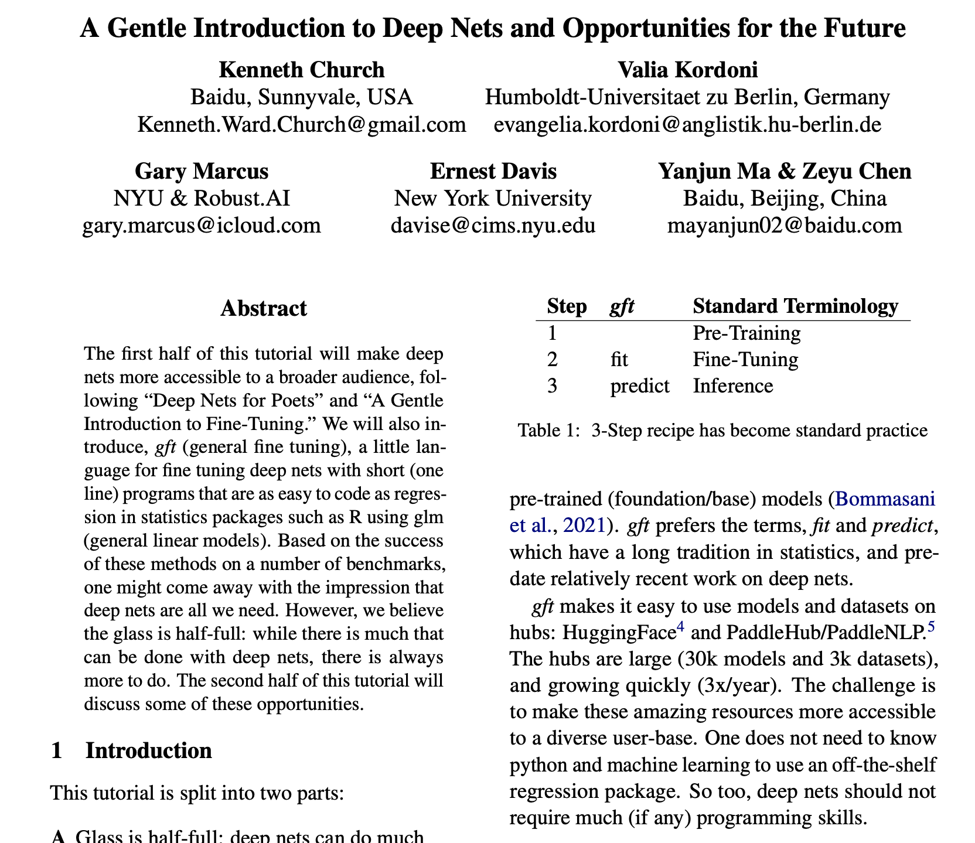
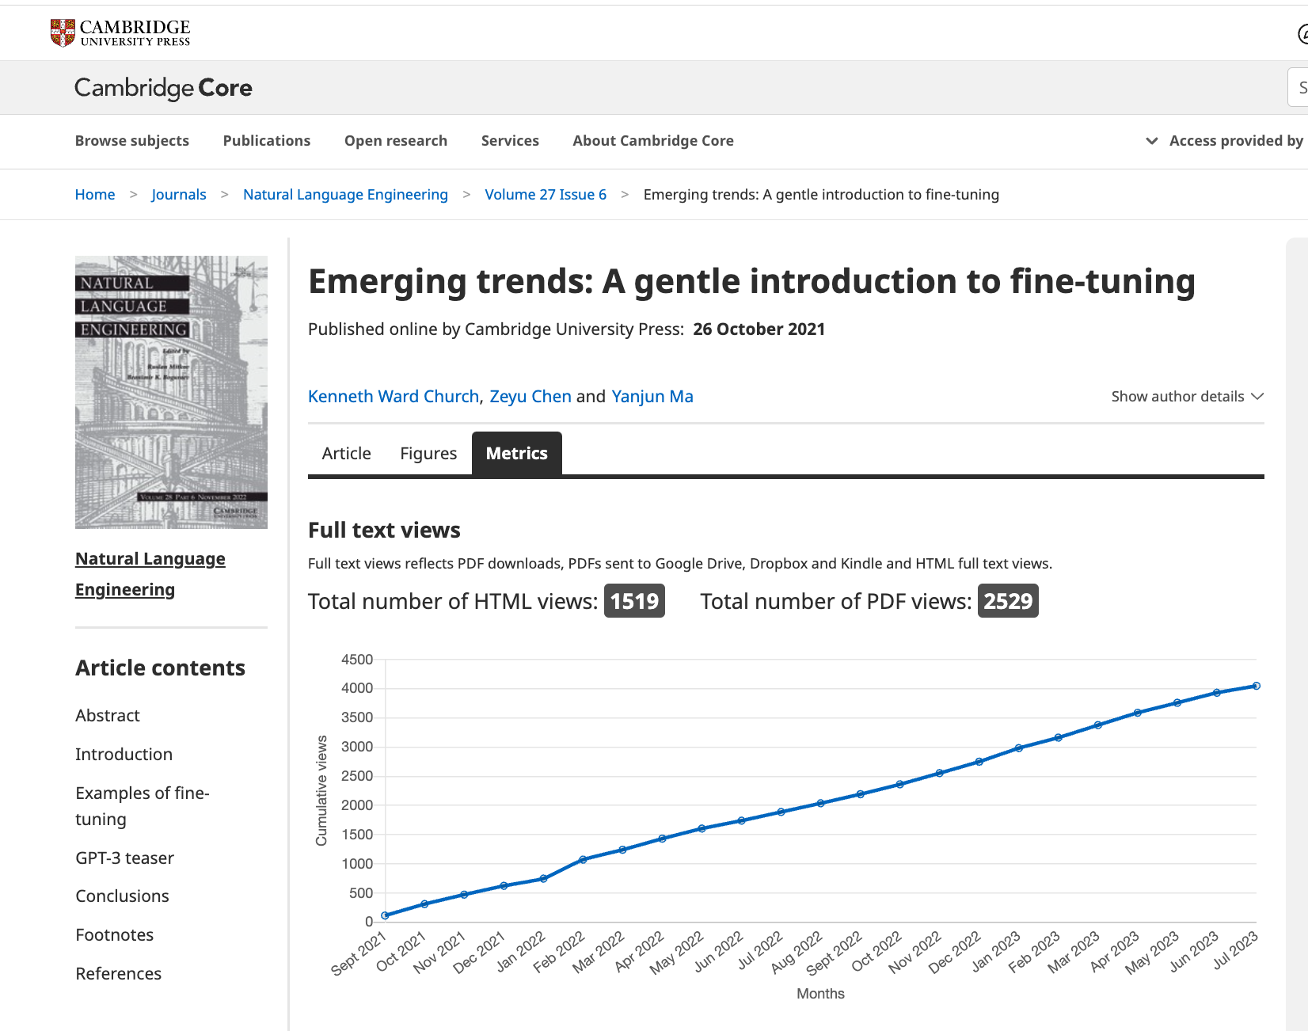
Shameless Plugs
https://github.com/kwchurch/ACL2022_deepnets_tutorial

Slide 12
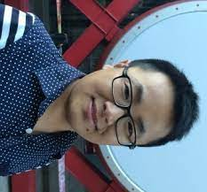
ACL-2022 Tutorial: Part A: Simple Uses of Deep Nets
Ken
Valia
Gary
Ernie
Yanjun
Zeyu
Ken Church, Baidu, USA
Valia Kordoni, Humboldt-Universitaet zu Berlin, Germany
Gary Marcus, Robust.AI
Ernest Davis, NYU
Yanjun MA, Baidu, China
Zeyu Chen, Baidu, China

Slide 13
Outline
Make deep nets accessible to masses (including non-programmers)
Part A: Glass is half-full
Deep nets can do much
Part B: Glass is half-empty
There is always more work to do
(Ugly)
Advocate combo of Part A with
AI Knowledge Representation
Linguistics and Philosophy
GFT Code,
100s of examples,
slides, videos, papers

Slide 14
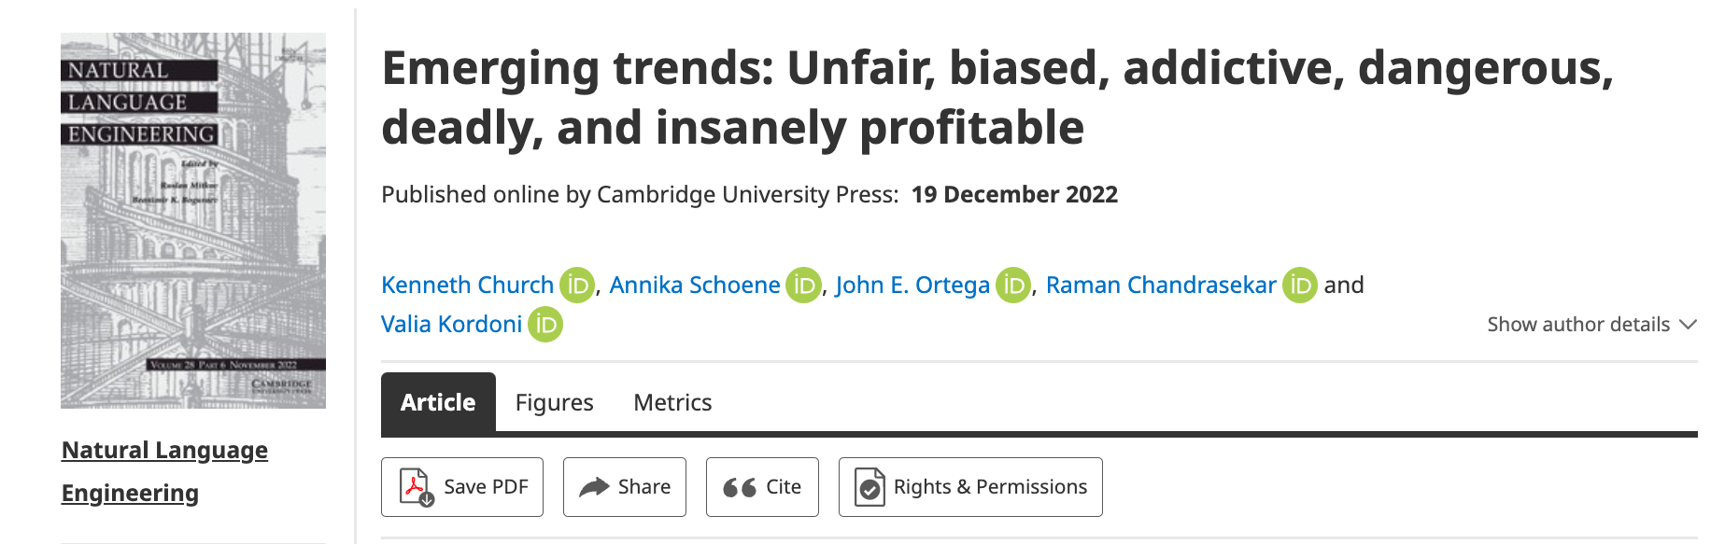
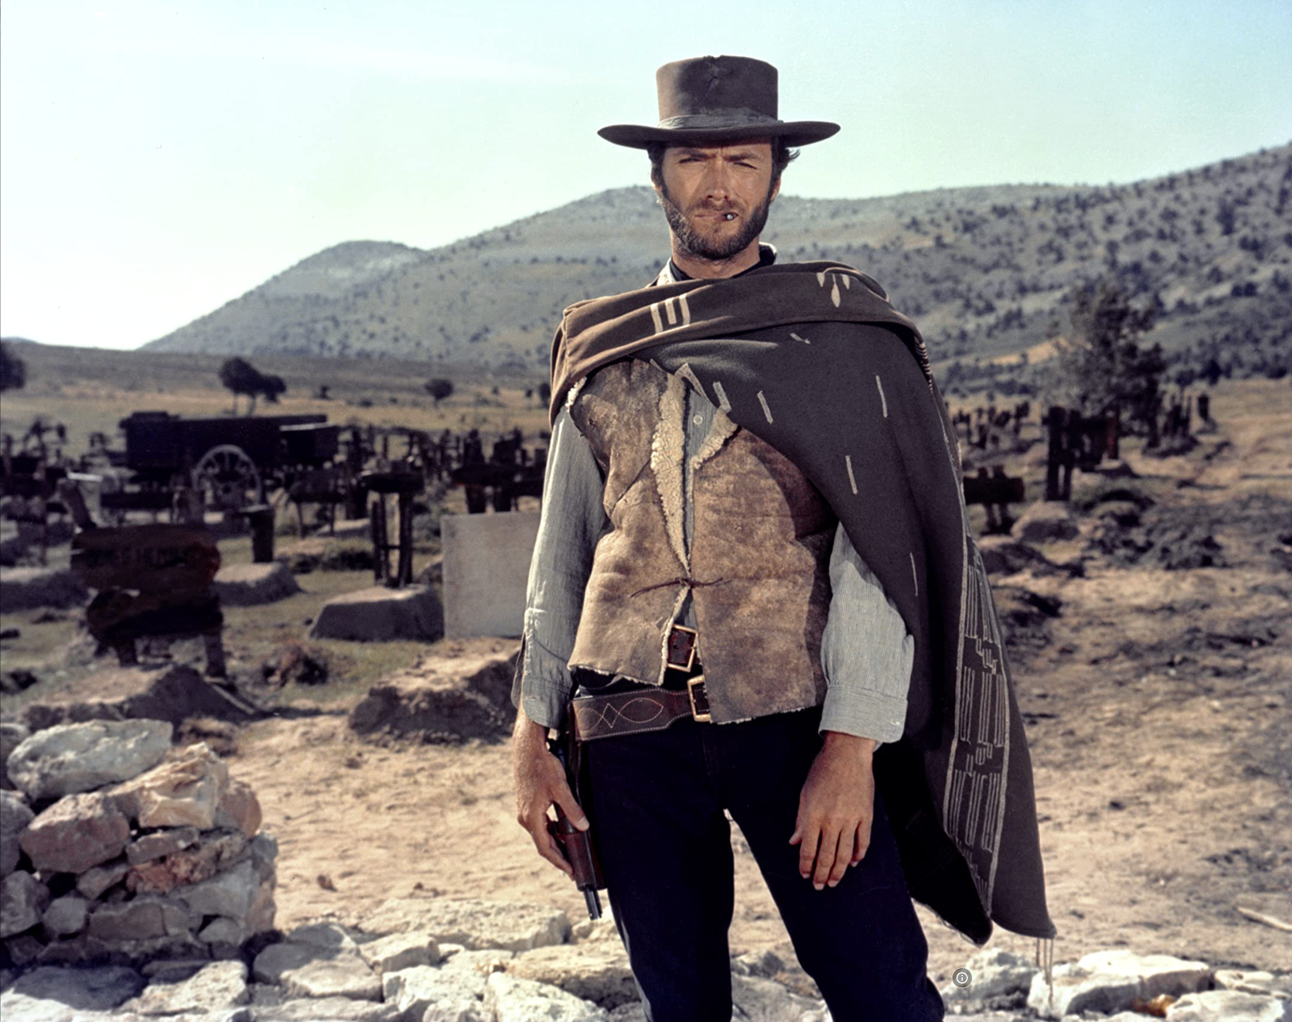
The Good, the Bad and the Ugly
Bias, toxicity, misinformation
Hallucinations
Plagiarism

Slide 15

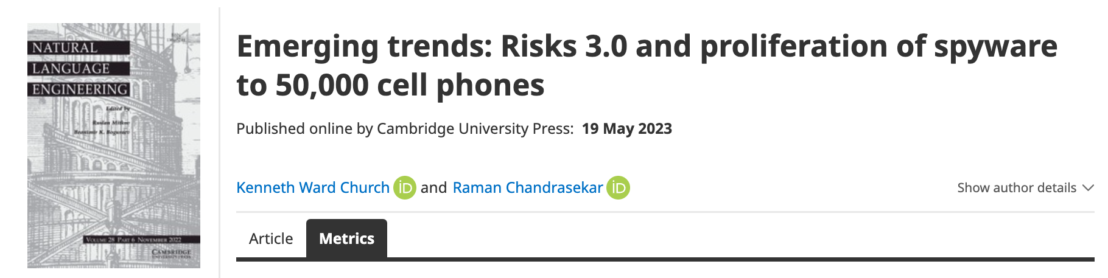
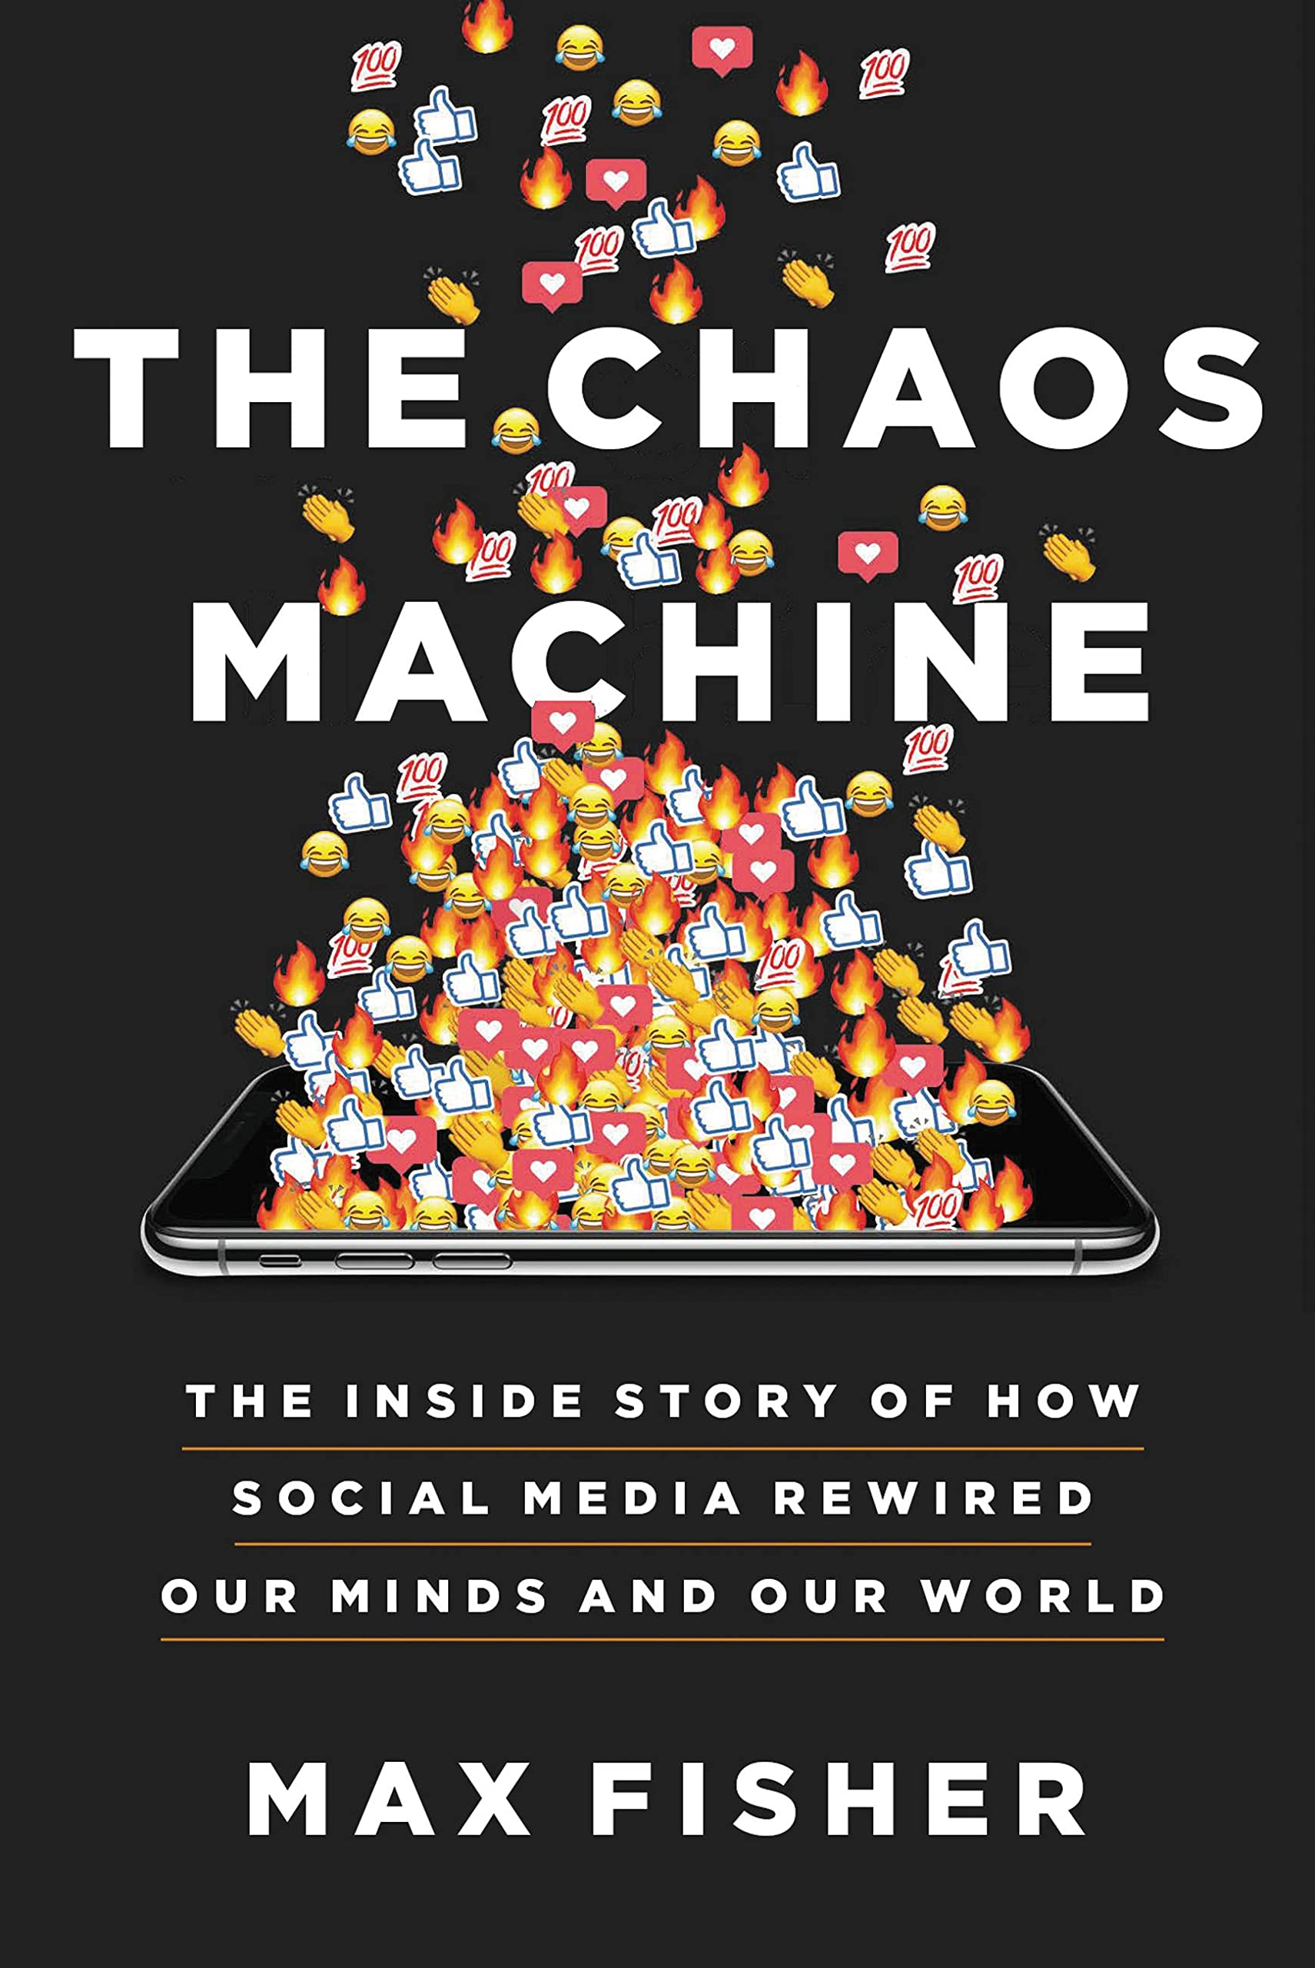



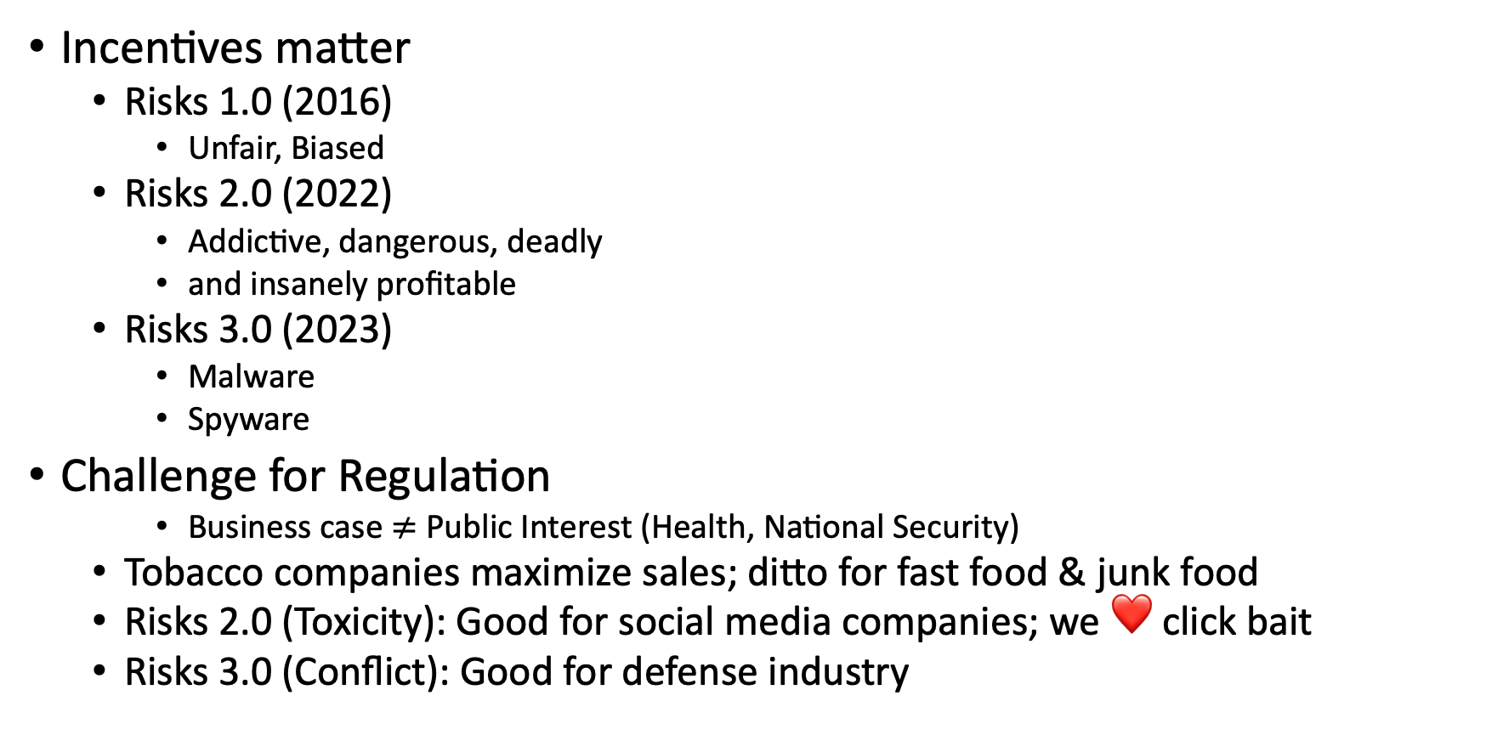
Ugly: Responsible AI
Incentives matter
Risks 1.0 (2016)
Unfair, Biased
Risks 2.0 (2022)
Addictive, dangerous, deadly
and insanely profitable
Risks 3.0 (2023)
Malware
Spyware
Challenge for Regulation
Business case $≠$ Public Interest (Health, National Security)
Tobacco companies maximize sales; ditto for fast food & junk food
Risks 2.0 (Toxicity): Good for social media companies; we ❤️ click bait
Risks 3.0 (Conflict): Good for defense industry

Slide 16
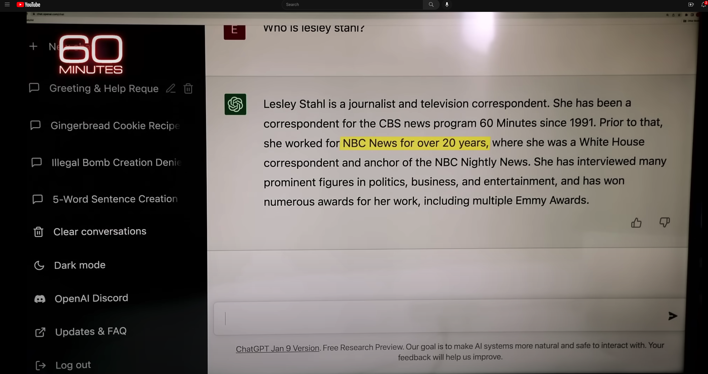

Hallucinations
Prompt
Language models
make up ``alternative facts’’
faster than fact-checking
Dangerous failure mode
People will believe these ``alternative facts’’
More fluent
than trustworthy
Smooth talking-machines
Hallucination
ChatGPT Hallucinates on CBS ``60 Minutes’’ https://www.youtube.com/watch?v=1wzPr4cUoMQ&t=463s
https://github.com/kwchurch/ACL2022_deepnets_tutorial
16

Slide 17
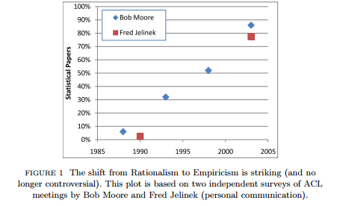
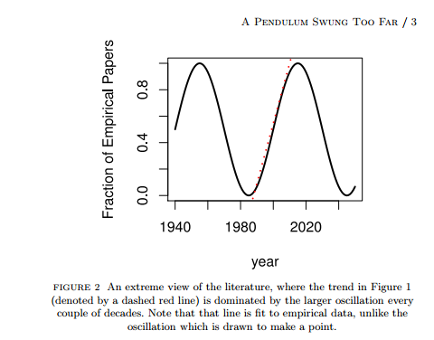
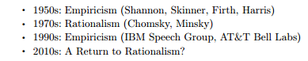
History: Pendulum Swung Too Far
⚠️ ⚠️ ⚠️ Warning ⚠️ ⚠️ ⚠️
Unrealistic Expectations → Winter
Mechanism
⚠️ ⚠️ ⚠️ Warning ⚠️ ⚠️ ⚠️
Unrealistic Expectations → Winter

Slide 18
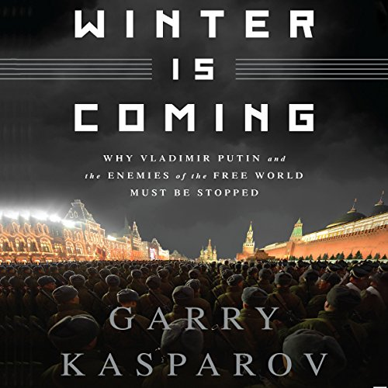
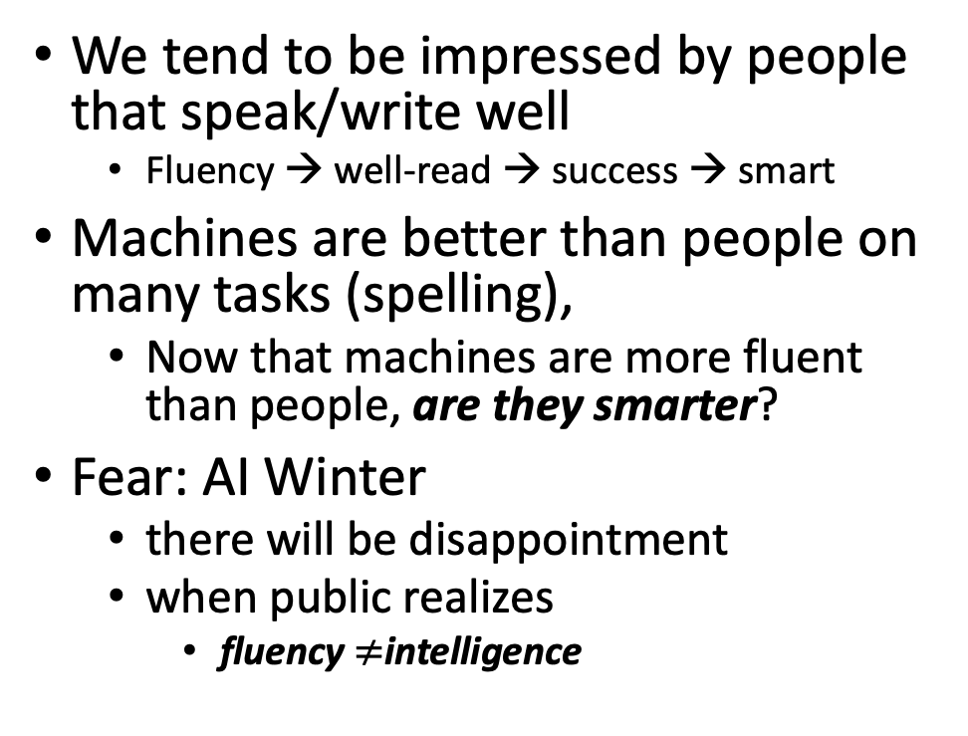
Winter is Coming
We tend to be impressed by people that speak/write well
Fluency → well-read → success → smart
Machines are better than people on many tasks (spelling),
Now that machines are more fluent than people, are they smarter?
Fear: AI Winter
there will be disappointment
when public realizes
fluency $≠$intelligence
Pendulum Swung Too Far
There have been many AI Winters
Often, after ``irrational exuberance’’
(like current excitement with nets)

Slide 19
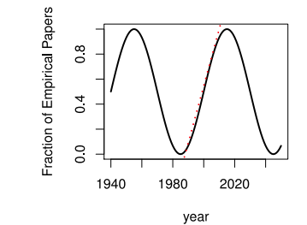
Large Language Models (LLMs) Strengths (1950s/1990s); Weaknesses (1970s)
Easy
Easy
Strengths (fluency)
1950s/1990s: Empiricism
Shannon, Skinner, Firth, Harris
You shall know a word by the company it keeps (Firth, 1957)
Collocations (Easy for Machines)
Distributional Hypothesis (Zellig Harris):
PMI, Word2Vec, BERT
No ``hard’’ stuff
Weaknesses (Hallucinations)
1970s: Rationalism (``Hard’’ Stuff)
Chomsky, Minsky
Truth: logic, possible worlds
Meaning
Purpose (Gricean Maxims)
Common Sense
Hard

Slide 20
Positive Opportunities for Machine Translation
Technology is good enough
that I could work for Baidu
even though my Chinese
is worse than my French
Functionality
Inputs: language → phones
camera, microphone, QR codes, net
documents (html, pdf, ppt, xls)
Outputs: phones → language
screen, speaker, net, etc.
Requirements: fluency, credibility, latency
Widely deployed (in China)
Everywhere: Hotels, taxis, shops, etc.
Anyone with a phone (everyone)
Knows how to use this stuff
Metrics suggest
Technology is better than humans
But I am more productive
with a human interpreter
Metrics are wrong: BLEU & latency
Human interpreters emphasize
What I need to know
When I need to know it
Machines translate
Everything (with equal emphasis)
I don’t trust machines (with terminology):
``ecology’’ vs ``eco-system’’
``corruption’’
It is exhausting second-guessing machines

Slide 21
Standard 3-Step Recipe
Step | Description | Time | Hardware
1
2
3 | Inference | Seconds/Minutes | 0+ GPUs
Easy

Slide 22


Inference: f(x) → y
Score

Slide 23


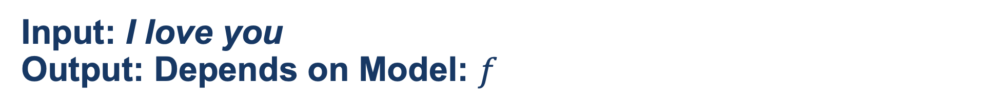
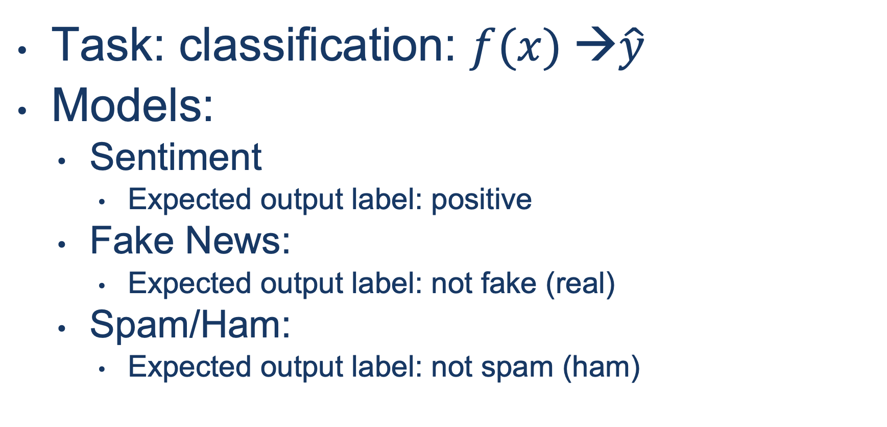
Input: I love you Output: Depends on Model: $f$
Task: classification: $f(x) →\hat{y}$
Models:
Sentiment
Expected output label: positive
Fake News:
Expected output label: not fake (real)
Spam/Ham:
Expected output label: not spam (ham)

Slide 24
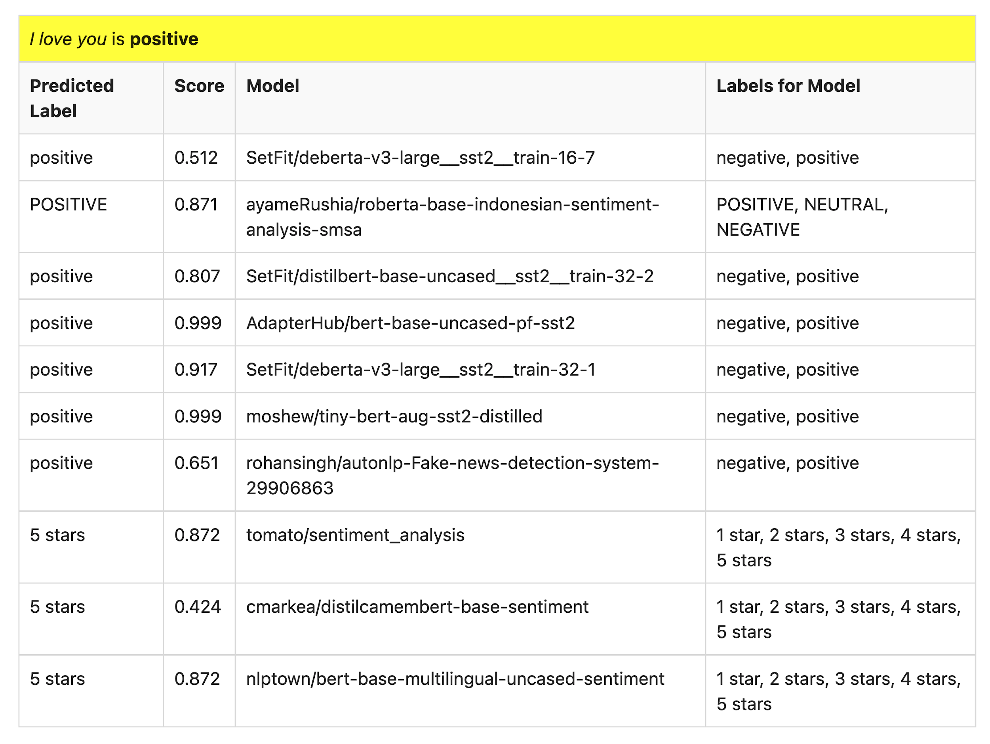
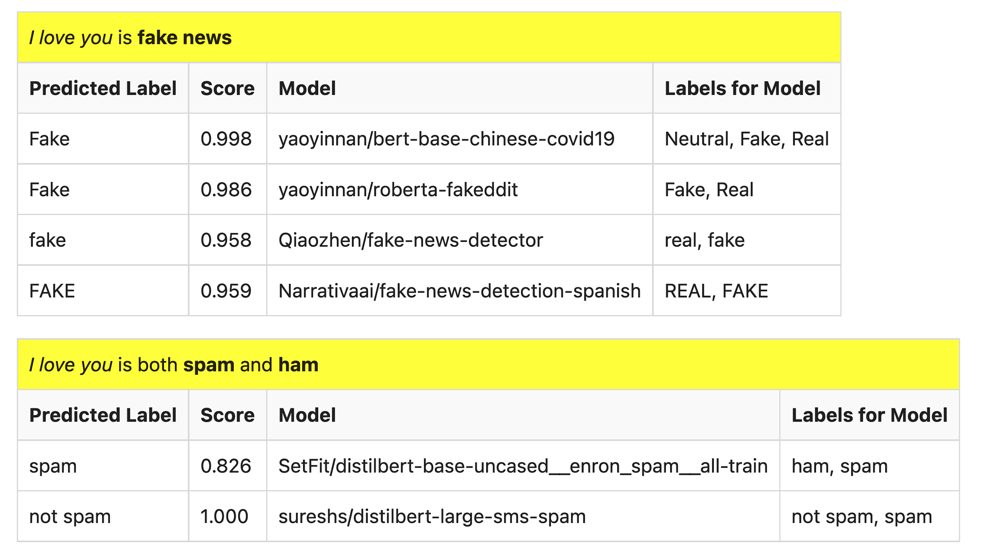
Many of these models produce reasonable results
Scores could be more confident

Slide 25
Lots of Models on Hubs (for lots of tasks)
Natural Language
Classification
Sentiment: positive/negative, 1-5 stars
Emotion classification
Hate speech classification
Guess missing word (fill-mask; cloze task)
Part of speech tagging
NER (named entity recognition)
Question Answering (SQUAD)
Entailment (GLUE)
Image Classification
Speech recognition
Machine Translation
Examples of fill-mask
echo … | gft_predict --task fill-mask
I <mask> you
miss|0.295
love|0.174
salute|0.158
I love the <mask> guy
pizza|0.035
funny|0.016
old|0.010
Examples of machine translation
echo …| gft_predict --task translation \
--model H:Helsinki-NLP/opus-mt-en-fr
I love you
Je t'aime.
2k translation models
on HuggingFace

Slide 26
Standard 3-Step Recipe
Most users should not do this themselves
Step | Description | Time | Hardware
1 | Pre-Training | Days/Weeks | Large GPU cluster
2
3 | Inference | Seconds/Minutes | 0+ GPUs

Slide 27
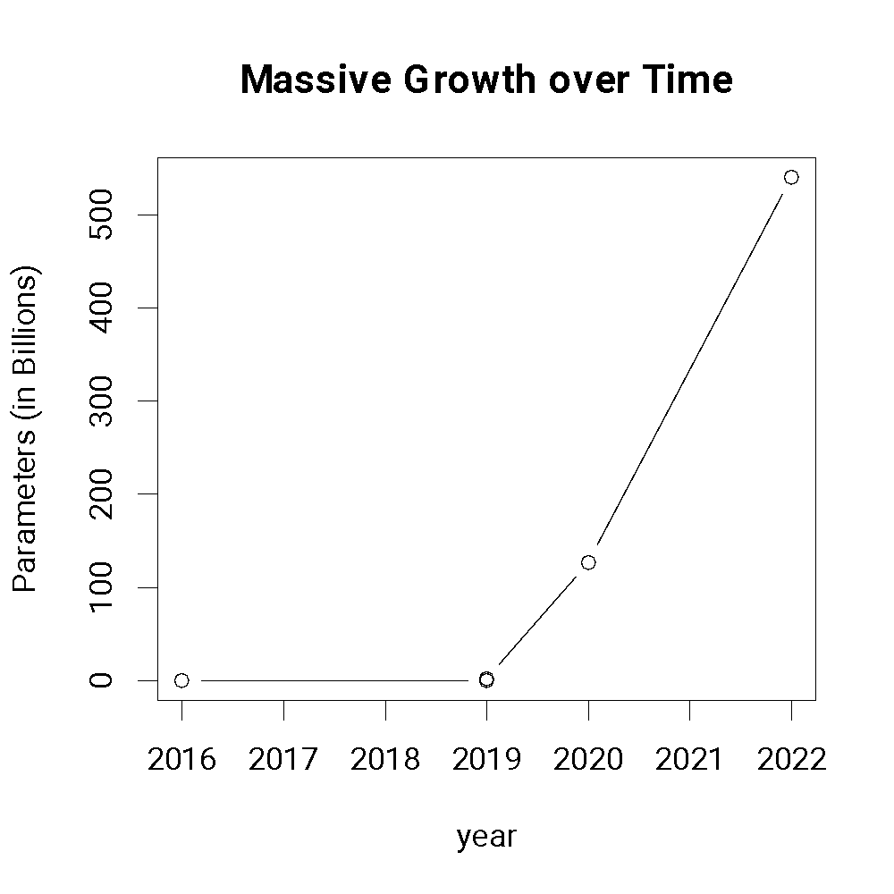
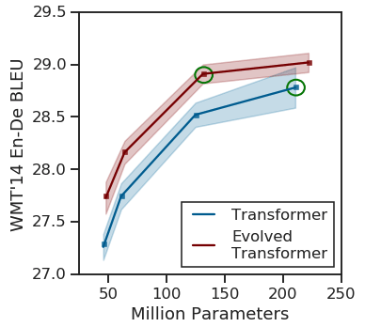
Most users should not invest in pretraining because growth (& costs) are out of control
A Rising Tide
Lifts All Boats

Slide 28
Standard 3-Step Recipe
Step | Description | Time | Hardware
1 | Pre-Training | Days/Weeks | Large GPU cluster
2 | Fine-Tuning | Hours/Days | 1+ GPUs
3 | Inference | Seconds/Minutes | 0+ GPUs
Not Hard

Slide 29
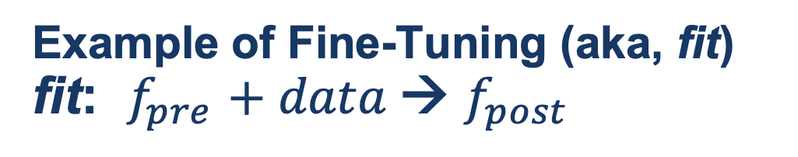
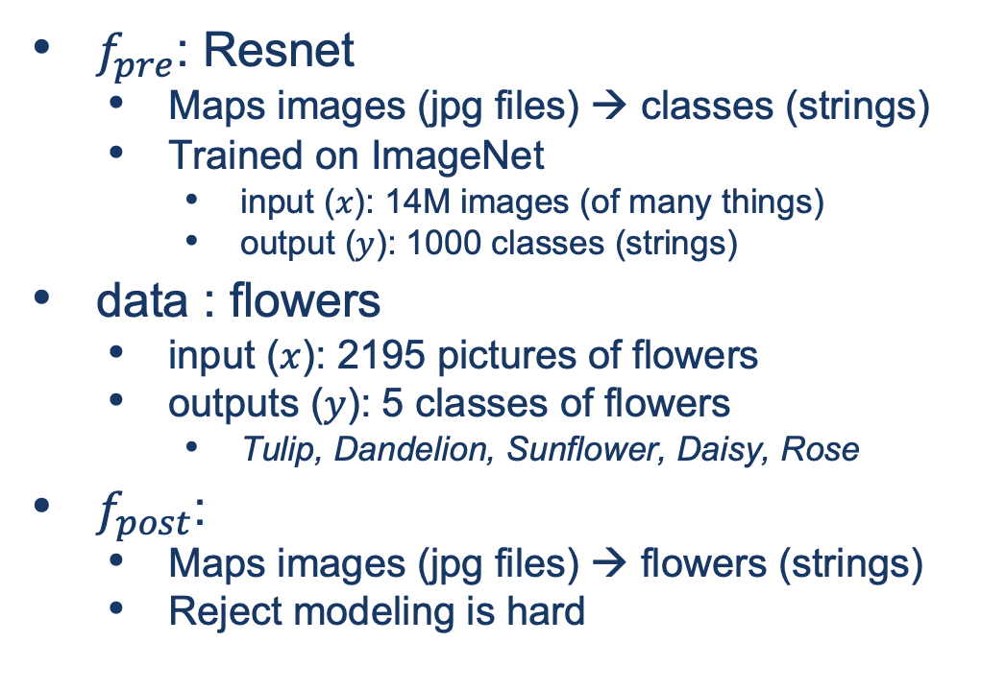
Guide Book App

